Slide 1
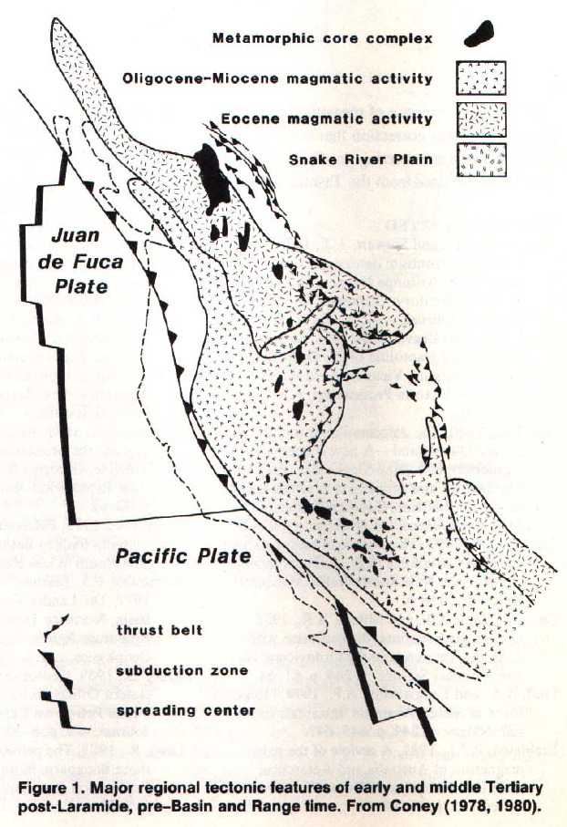
Addresses historic debate around the origin of core complexes (extension vs compression)

Slide 2
Location of Core Complexes
Composed of older metamorphic rocks that are overprinted by low-angle metamorphic fabrics
Core complexes are found in a belt from Mexico to Canada
Found in the hinterland of orogenic belts
Coincide with zones of Cenozoic magmatic and volcanic activity
To the north of the Snake River Plain, core complexes date to the Eocene
To the south of the Snake River Plain, core complexes date to the Oligocene-Miocene

Slide 3
Historical Controversy
Are core complexes the result of compression or extension?
This has implications on the age of formation
Compressional tectonics were active in the Great Basin broadly from Jurassic to Eocene
Extensional tectonics were primarily active from the Eocene onwards

Slide 4
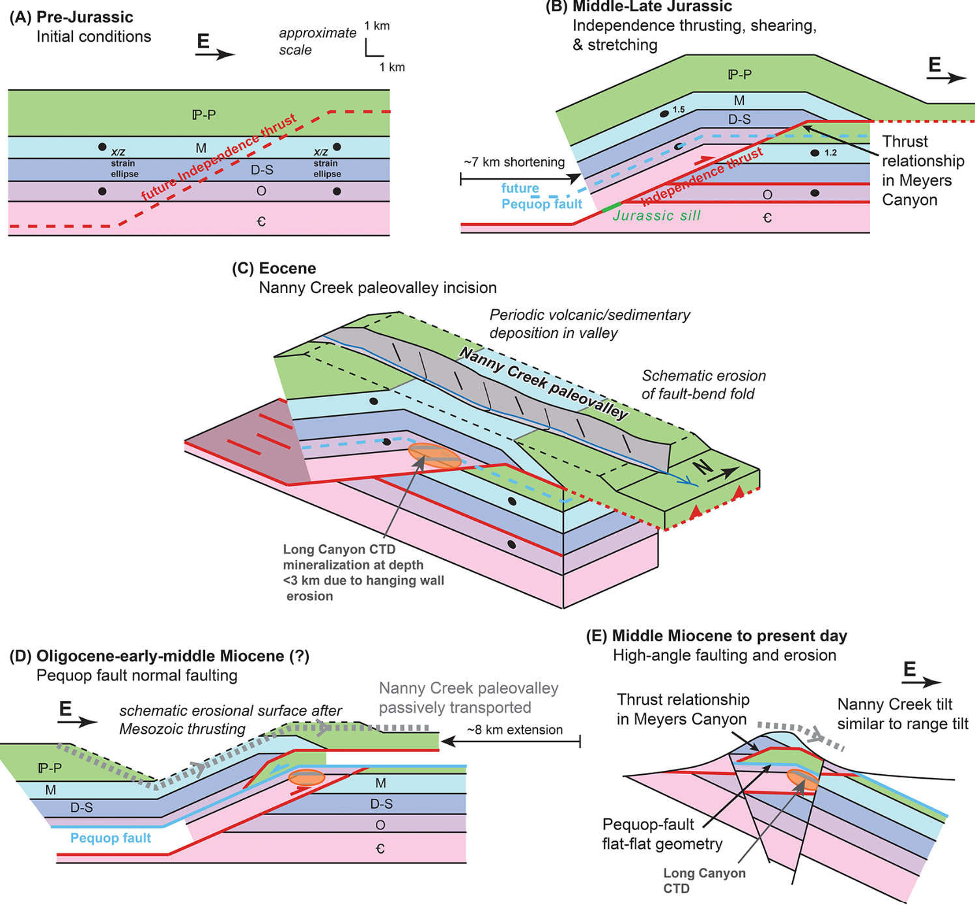
Historical Controversy: Continued
Historically viewed as compressional in origin based on structures and metamorphism
However, metamorphic cooling histories suggested relatively young ages and that the low-angle overprinting fabrics were related to deep-seated extensional structures
Each camp minimized the other camps arguments and evidence
A recent study by Zuza (2021) on the Pequop/Ruby Mountains shows how multiple-generations of structures can produce complicated histories leading to misunderstandings.
Zuza (2021)

Slide 5
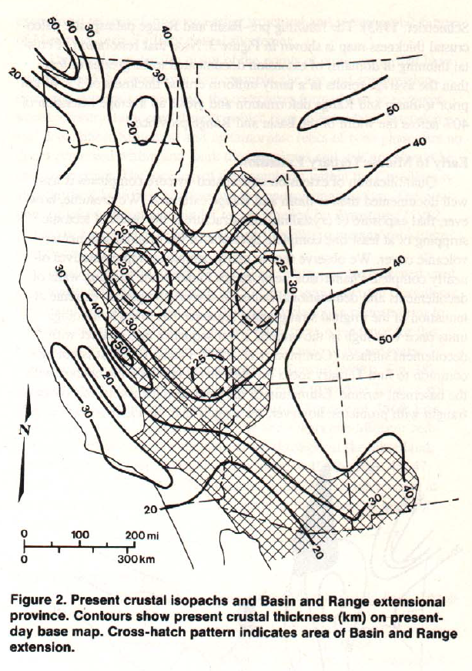
Method
The goal is to determine crustal thicknesses through time
Involves assuming a certain extensional value for a period and restoring for it using current crustal thicknesses as a baseline

Slide 6
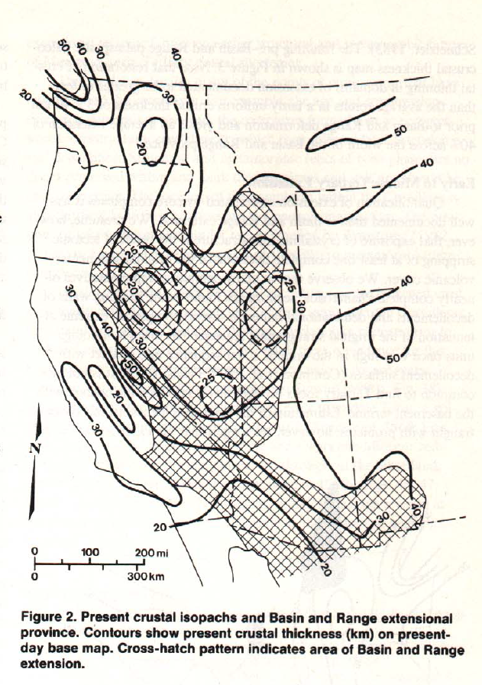
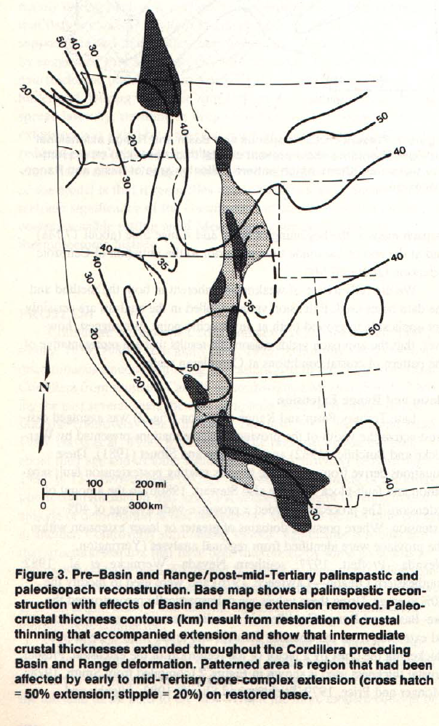
Crustal Thickness before the Basin and Range
Current crustal thickness
Crustal thickness prior to B&R
To back calculate, 40% extension was assumed
Assumed using tilts in mountain ranges and equations from the tilted-fault block model.
Local extension values were modified for ranges that had high or low extension values
Results in a paleoisopach map showing crustal thicknesses typically from 35-40km.

Slide 7
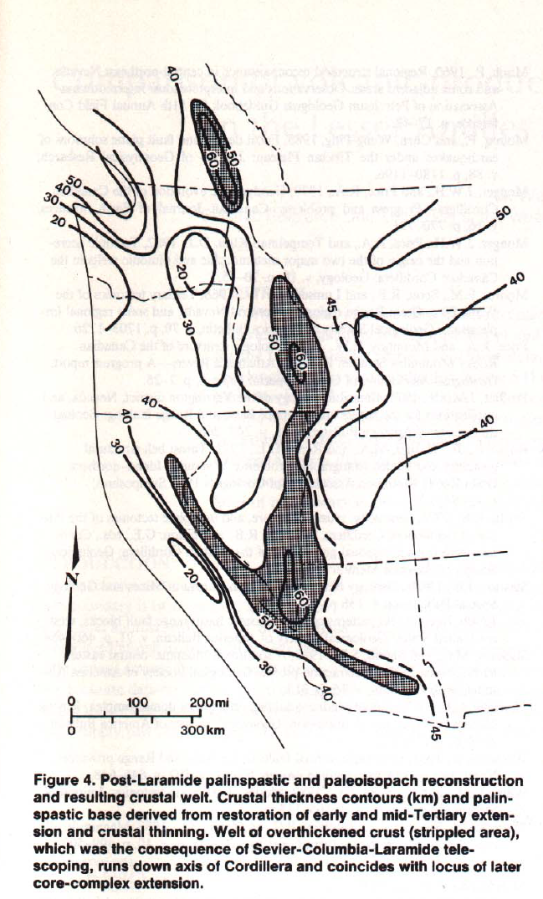
Crustal Thickness before the Early- to Middle-Tertiary
Current crustal thickness
Crustal thickness prior to Tertiary extension and after Mesozoic shortening
Core complexes restore to zone of highest crustal thicknesses
The amount of extension in the Tertiary is less well-constrained than B&R.
Coney uses inferences
For core complexes, 10km of stripping is assumed which results in extensional values from 40-60%
Coney admits to the circularity of their method (extension results in thickening where extension is restored)

Slide 8
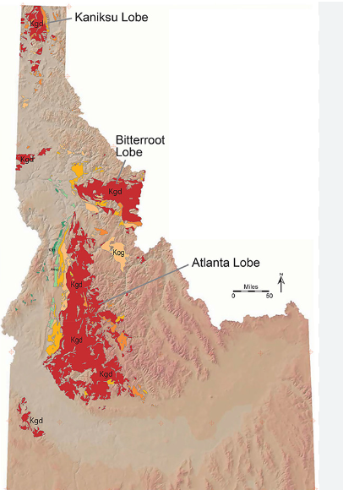
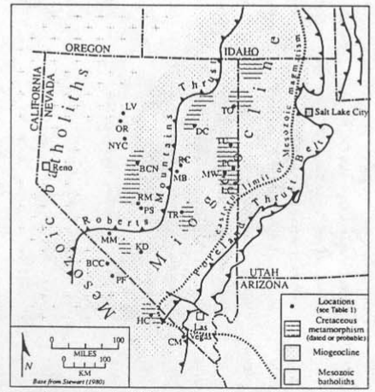
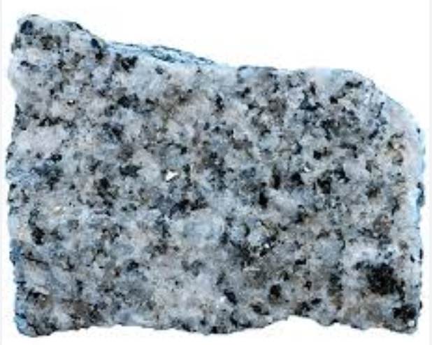
Shortening
Crustal thickness prior to Tertiary extension and after Mesozoic shorterning
Idaho batholith zones
(some two-mica granite phases)
Core complexes restore to zone of highest crustal thicknesses
Coney argues that his estimated crustal thicknesses agree with prior authors estimates of shortening
The two-mica granites found in the Basin and Range date to 65-105 Ma (Barton and Trim, 1991)
Two-mica granites are thought to have formed in thick continental crust (think Himalayas)
They commonly form in continent-continent collisions.
Shorterning increases in the hinterland of thrust belts
In some areas the compressional orogenies telescoped on each other producing thick crust
For example, Southeast Canada where Jurassic to Tertiary compression
Barton and Trim (1991)
Two-mica granite

Slide 9
Implications
Crustal thickness prior to Tertiary extension and after Mesozoic shorterning
Core complexes restore to zone of highest crustal thicknesses
Other studies around this time argued that thickened crust will spread laterally when confining pressures and viscosity are lowered
For the core complexes:
Post-Laramide (~55 Ma) volcanism and magmatism lowered the viscosity
A drop in the convergence speed in the subduction zone to the west reduced confining pressure

Slide 10
Conclusions
Core complexes restore to zone of highest crustal thicknesses
Palinspastic reconstructions show that core-complexes formed in areas where the crust was significantly thickened
This explains the controversial compressional versus extensional origin of core-complexes
Core complexes formed as a result of compression, extension, and volcanism
These influenced each other
Core complex age generally coincides with the age of the surrounding volcanic/magmatics pulses

